Slide 1

Lecture 5
How to write a report
1

Slide 2

Lecturer details
What is report?
Why report is written?
Content and structure of report
2

Slide 3







What is report
3

Slide 4



Why report is written
To Document
To put results in scientific context
To add to human knowledge archive
4

Slide 5
Structure of a report
1
Title Page
9
References and appendices
2
Abstract
Report
3
Acknowledgement
8
Conclusions and recommendations
4
Content
7
Results and findings
6
Literature review
(Research background)
5
Introduction
5

Slide 6

1. Title page
Name of the university
Title of report
Author’s name
Student No(if you have any)
Module/course details/ topic detail
Date of the report
Word count of the report
6

Slide 7

2. Abstract
The main task
The methods used(Optional)
The conclusions reached
The recommendations made
7

Slide 8
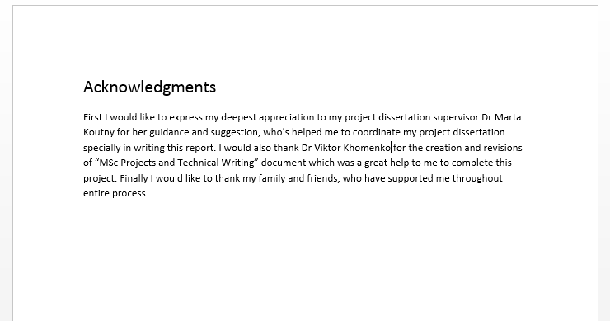
3. Acknowledgement
Acknowledged all sources of help
8

Slide 9
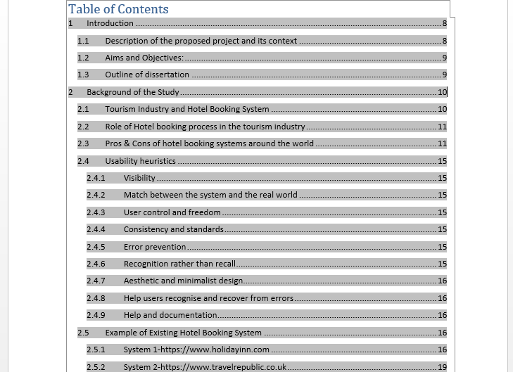
4. Content page
List all the main sections in sequence
Included a list of illustrations
9

Slide 10

5. Introduction
Description of the proposed project and its context
Aims and Objectives
Outline of the report
10

Slide 11
6:Literature review(Research background)
Focus on previous research.
Shown how your study fills the “gap”
The necessity for your study.
Sets boundaries(Limitation of the studies).
11

Slide 12

7: Results and finings
A complete description of the results presented in the form of words, tables,
diagrams, graphs and maps.
Clear material analysis and evaluation
Clear and simple diagrams
Clear label of the findings
12

Slide 13

8. Recommendation and conclusion
Meeting Objectives
Positive and negative aspects
Reflective Learning
Scope of future research(Recommendation)
13

Slide 14

9. References
List all references alphabetically or numerically
Included all the necessary information
Make sure references are accurate
14

Slide 15
Plagiarism
Using the ideas, words or data of others as if it is your own
Don’t do it!!!
It is lying, cheating, stealing and unethical
But a paper full of others’ citations is not a paper
Put others ideas and citations into “ --” and reference it even if you rephrase.
15

Slide 16
End
Thank you
??????
15

